Slide 1


Chapter 10 Resolving Names to IP Addresses

Slide 2

Chapter 10 Overview
Exploring types of names used in networks
Exploring types of name resolution
Identifying the steps in name resolution

Slide 3
Exploring Types of
Names Used in Networks
Progression of name resolution
  Computer name
  IP address
  MAC address
  Bits (ones and zeros)

Slide 4
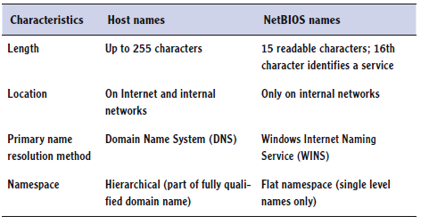
Exploring Types of
Names Used in Networks
Host names

Slide 5
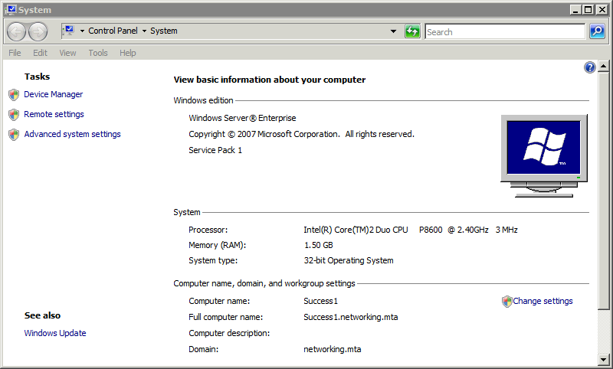
Exploring Types of
Names Used in Networks
Understanding host names

Slide 6
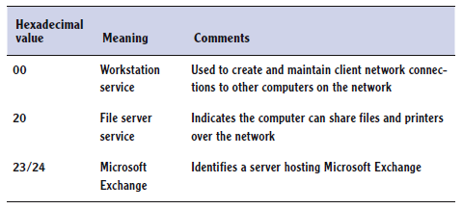
Exploring Types of
Names Used in Networks
Understanding NetBIOS names
  15 characters long
  Hidden 16th byte describes service

Slide 7
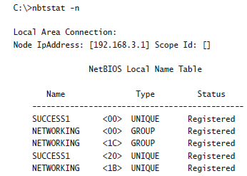
Exploring Types of
Names Used in Networks
Understanding NetBIOS names
  Viewing names

Slide 8
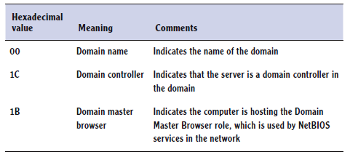
Exploring Types of
Names Used in Networks
Understanding NetBIOS names
  Domain names have different services

Slide 9
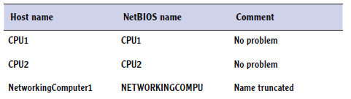
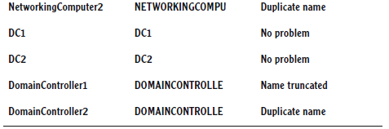
Exploring Types of
Names Used in Networks
NetBIOS names created from host names

Slide 10
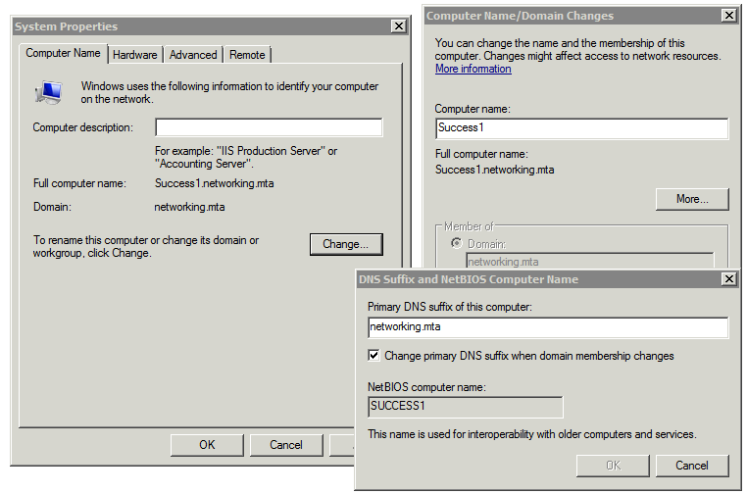
Exploring Types of
Names Used in Networks
Viewing and modifying a computer name

Slide 11
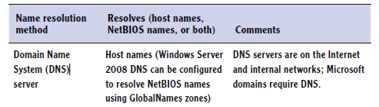
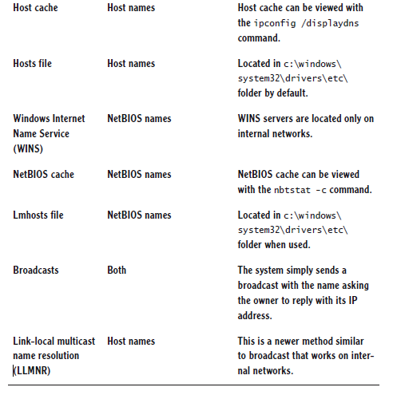
Exploring Types of
Name Resolution

Slide 12
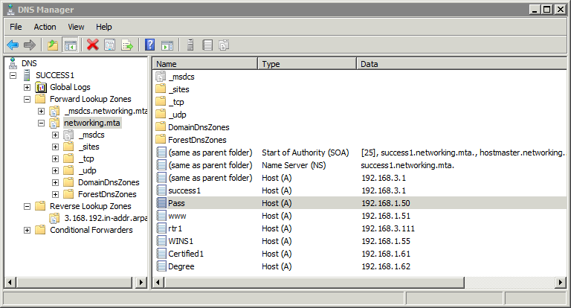
Exploring Types of
Name Resolution
Understanding DNS

Slide 13
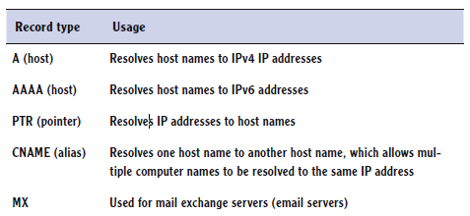

Exploring Types of
Name Resolution
Understanding DNS

Slide 14
Exploring Types of
Name Resolution
DNS hierarchy
  DNS root servers
  Top-level domain DNS servers
  Second-level domain DNS servers
  Third- and lower-level domain DNS servers

Slide 15
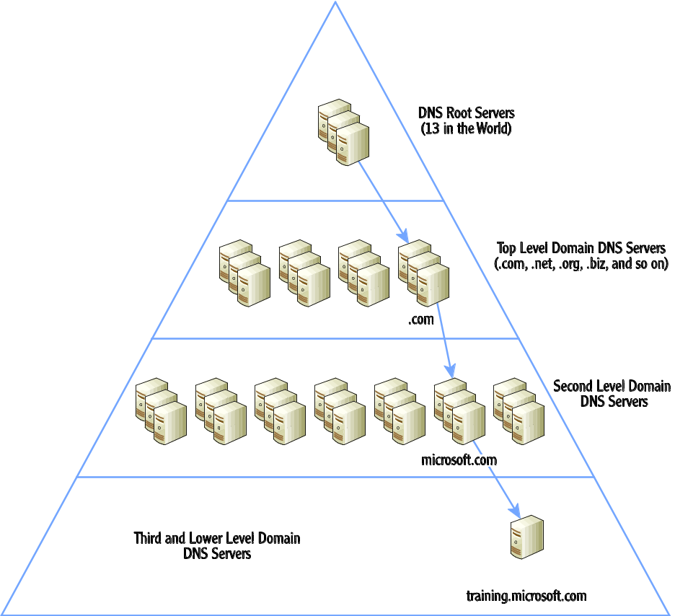
Exploring Types of
Name Resolution
DNS hierarchy

Slide 16
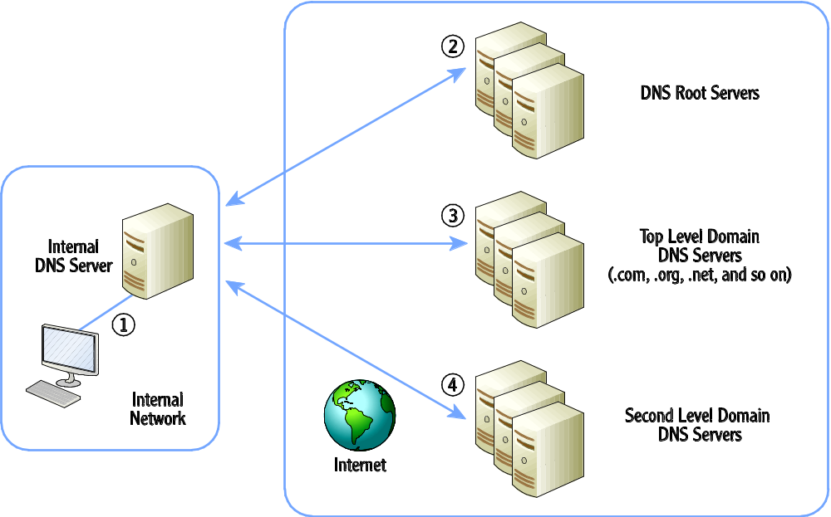
Exploring Types of
Name Resolution
Resolving a DNS query

Slide 17
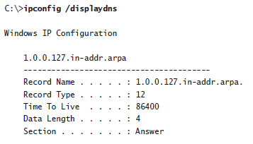
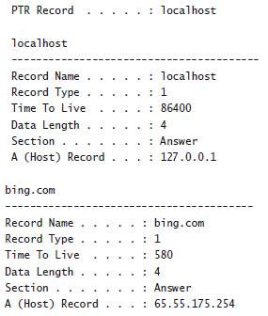
Viewing the Host Cache

Slide 18

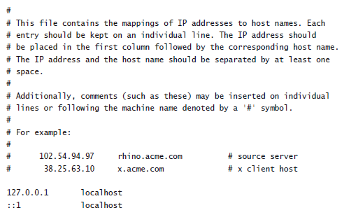
Viewing the Host File

Slide 19
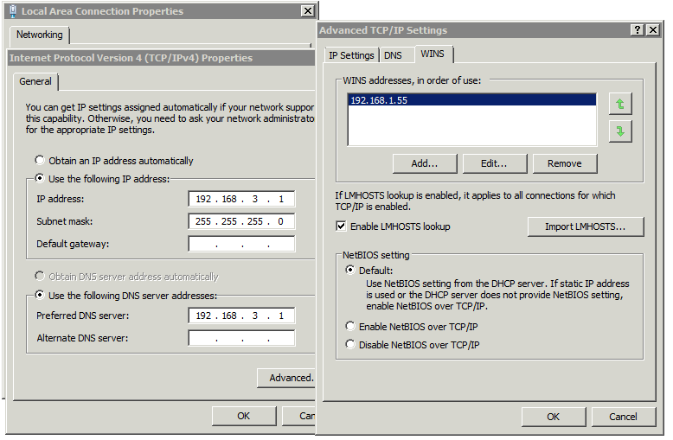
Exploring Types of
Name Resolution
Understanding WINS

Slide 20
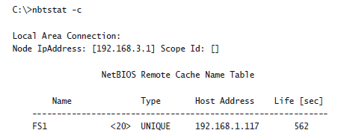
Exploring Types of
Name Resolution
Viewing the NetBIOS cache

Slide 21
Exploring Types of
Name Resolution
Understanding the lmhosts file
Understanding broadcasts
Understanding link-local multicast name resolution

Slide 22
Identifying the Steps in Host Name Resolution
Queried name same as host?
2. Name in host cache?
  Includes hosts file
3. Query DNS
4. Name in NetBIOS cache?
5. Query WINS
6. Broadcast
7. Lmhosts file

Slide 23
Identifying the Steps in NetBIOS Resolution
Name in NetBIOS cache?
Global Names zone (GNZ)
Query WINS
Broadcast
Queried name same as computer?
6. Host cache
  Includes hosts file
7. Query DNS

Slide 24
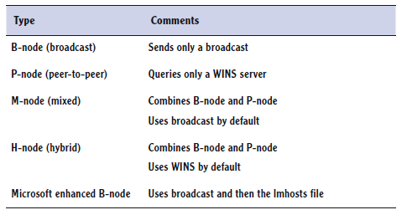
Identifying the Steps in NetBIOS Resolution
NetBIOS node types

Slide 25
Chapter 10 Summary
Exploring types of names used in networks
Exploring types of name resolution
Identifying the steps in name resolution

